Slide 1

Introduction to Cyber Security
Ritesh Dhanare
Assistant Professor
Information technology Department

Slide 2
Table of Contents
Key Information Security Concepts
Characteristics of Information
Vulnerabilities
Threats
Attacks and
controls

Slide 3
Key Information Security Concepts
Access: A subject or object’s ability to use, manipulate, modify, or affect another subject or object.
Asset: The organizational resource that is being protected.
Attack: An intentional or unintentional act that can cause damage to or otherwise compromise information and/or the systems that support it.

Slide 4
Key Information Security Concepts
Attack: An intentional or unintentional act that can cause damage to or otherwise compromise information and/or the systems that support it.
Exploit: A technique used to compromise a system.
Exposure: A condition or state of being exposed.

Slide 5
Key Information Security Concepts
Loss: A single instance of an information asset suffering damage or unintended or unauthorized modification or disclosure.
Protection profile or security posture: The entire set of controls and safeguards, including policy, education, training and awareness, and technology, that the organization implements (or fails to implement) to protect the asset.

Slide 6
Key Information Security Concepts
Risk: The probability that something unwanted will happen.
Subjects and objects: A computer can be either the subject of an attack—an agent entity used to conduct the attack—or the object of an attack—the target entity.
Threat: A category of objects, persons, or other entities that presents a danger to an asset.

Slide 7
Key Information Security Concepts
Threat agent: The specific instance or a component of a threat.
Vulnerability: A weaknesses or fault in a system or protection mechanism that opens it to attack or damage.

Slide 8
Characteristics of Information
Availability
Accuracy
Authenticity
Confidentiality
Integrity

Slide 9
Vulnerabilities
A vulnerability is a weakness in the system, for example, in procedures, design, or implementation, that might be exploited to cause loss or harm.
For instance, a particular system may be vulnerable to unauthorized data manipulation because the system does not verify a user’s identity before allowing data access.

Slide 10
threat
A threat to a computing system is a set of circumstances that has the potential to cause loss or harm.

Slide 11
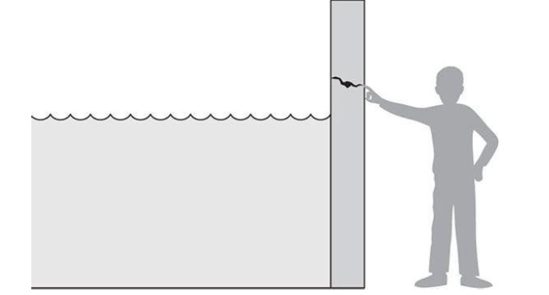

Slide 12
How do we address these problems?
We use a control or countermeasure as protection. That is, a control is an action, device, procedure, or technique that removes or reduces a vulnerability.

